Slide 1














Operational Threat & Risk Information Sharing and Analytics
TEAM Threat
Initial Submission

Slide 2
Submitters and Contributors (Thus Far)
Information Sharing Environment (ise.gov)
Demandware
U.S. Air force
U.S. Defense Security Services
California Public Safety (http://www.Caloes.ca.gov)
U.S. National Information Sharing Model PMO (https://www.niem.gov/)
Duke Energy
NSA/UCDMO
NIST
INCOSE
Integrated Networking Technologies, Inc.
Tibco Software Inc.
Hitachi
NC4
Others pending approval
Model Driven Solutions division of Data Access Technologies
KDM Analytics, Inc.
International Business Machines, Inc.
RSA, The Security Division of EMC
Lockheed Martin, Inc.
Oracle Corporation

Slide 3
Team Threat Open Collaborative Process
Submission posted for comment on our GIT site
https://github.com/omg-threat-modeling/phase1/tree/master/Submission
Weekly collaboration meetings, technical sessions as needed
Open to new contributors, substantial model evolution expected
Development of threat/risk community of interest
http://www.threatrisk.org
OMG Process is a part of this, but community is broader
All submission teams welcome, but not for OMG process

Slide 4
Problem Space
There is a critical need to understand and mitigate threats and risks – to “connect the dots”.
The Landscape of threats is changing
Multiple attack vectors, cyber and other
Advanced threats utilize multiple vulnerabilities
No comprehensive consistent semantic framework
Existing systems (such as corporate GRC solutions) allow insular treatment of threat/risk relationships
Comprehensive system would allow system-of-systems interoperability (private/private, public/private)

Slide 5
We have critical needs for analytics and information sharing
Cyber
Crime
Terrorism
Critical Infrastructure
Natural
Disasters
Sharing & Analytics
Sharing & Analytics
Sharing & Analytics
Sharing & Analytics
Sharing & Analytics
Threat and risk
Identification, assessment, mitigation, situational awareness
Risks and threats from threat actors and natural sources cross domains
Yet the information sharing and analytics capabilities are stove piped

Slide 6
The Opportunity
Integrated threat and risk management across
Domains
Cyber, Criminal, Terrorism, Critical Infrastructure, Natural disasters, others…
Across network fabrics (e.g. classified, unclassified, open)
Products and technologies
Enterprise risk management, cyber tools, disaster planning, etc…
Organizations
Government (Global, National, State, Local, Tribal), Non-governmental organizations, Commercial
Leading to
Shared awareness of threats and risks
Federated information analytics (including “big data”)
Improved mitigation of threats and risk
Situational awareness in real time
Big data analytics
Ability to respond and recover

Slide 7
The Challenge
There are dozens of standards, exchange schema and technologies for each domain
Each uses different terminology, structure and schema to represent the same or overlapping concepts
These only work together inside of proprietary products. No one product could ever cover the entire scope
Organizations with different or multiple products can’t integrate
There is even less capability across domains
Threat actors and natural disasters don’t respect our stovepipes, they exploit them
Impact: Our capacity for coordinated mitigation and response is severely compromised

Slide 8
Primary classes of use cases
Transformation from one information sharing data format to another
Example: NIEM to a CAP Alert
Analytics of information federated from multiple sources
Examples:
Fusion center “connects the dots” between a stolen laptop (from NIEM) and a cyber incident (From STIX)
Bio hazard detected by automated instruments and collaborated by local health care professionals

Slide 9
What we need is an integrating framework that supports automated data mapping
Cyber
Crime
Terrorism
Critical Infrastructure
Natural
Disasters
Integrating Framework for Threats and Risks
Sharing & Analytics
Sharing & Analytics
Sharing & Analytics
Sharing & Analytics
Sharing & Analytics
An integrating framework that helps us deal with all aspects of a risk or incident
A federation of risk and threat information sharing and analytics capabilities

Slide 10
Scope Diagram
Wide & shallow conceptual model generically covering threats and risks
Other risks (Out of scope)
Operational Threat & Risk Concepts
High level Cyber-threat/risk concepts
Law Enforcement / Emergency Management Concepts
Physical. Spectrum, facilities,
Probabilities, Forensic, Chemical, Biological, Medical, Nuclear, Military and Intelligence threats concepts
STIX/TAXII/Cybox
IODEF
SACM
ISO
NIST
Others…
NIEM Threat/Risk Representation
Other Risks
Systemic Risk
Credit Risk
Market Risk
Pension Risk
Reputation Risk
Liquidity Risk
Legal Risk
Project Management Risk
Legend
Normative
(Formal Specification)
NIEM Exchanges
EDXL / CAP
Others…
Other Inputs
In Scope with Limited Detail
Informative

Slide 11
Approach
Highlight O(N) vs. O(N^2)
Cyber
Terrorism
Construct a conceptual model informed by existing schema, research and best practices
This conceptual model is independent of specific data structures, technologies and terminologies
Define mapping models between the conceptual model and purpose/organizational schema
Make both models sufficiently precise that they can drive automated bridging between any mapped schema
Cyber
Cyber
Cyber
Disasters
Map/Bridge
Map/Bridge
Map/Bridge
Conceptual Model
Map/Bridge
Map/Bridge
Criminal
Cyber
Criminal
Infrastructure

Slide 12
Critical Components – conceptual models and mappings
External
Conceptual Modeling Profile (From SIMF)
Mapping Profile (From SIMF)
XSD Profile
(From IMM)
Depends On
Uses
Uses
Uses
Uses
Generic and threat-risk conceptual models
STIX/Cybox Mapping
STIX/Cybox UML Import
NIEM Mapping
NIEM-UML
More…
More…

Slide 13

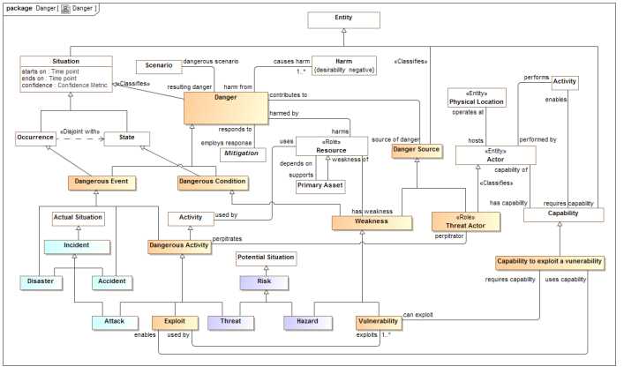
Conceptual Model Inputs
KDM
(Risk)
NIST Framework
Conceptual Model
NIEM
(General)
STIX
(Cyber)
OGC
(Geo)
EDXL
(Emergency)
FIBO (Finance)
SEI
(Safety)
CAL OES
(Health)
MAP
ISO
(Risk)
ISO
(Units)
RMS
(Custody)
STIX, NIEM, EDXL, Others
There is still more to do to fully integrate the above and we anticipate more inputs and use cases

Slide 14
Understanding the conceptual models

Slide 15
Conceptual Model Layering
Operational threat situational awareness and response
Operational risk evaluation and mediation
Cross-risk/threat – specific “wide and shallow” risk and threat concepts/ E.G. Risk, threat, danger, consequence
Generic Library – Provides concepts and links across multiple viewpoints, not just threat/risk. E.G. Person, Objective
Kernel– Foundational concepts for modeling anything: Entities, Roles, Relations, Types, Information, Rules, Identity, Etc…
Subset of the model from SIMF

Slide 16
Conceptual Model Packages
Core Concepts
Foundation
Identifiers
Information
Process
Quantities and Units
Rules
Templates
Timeframe
Generic Concepts
Authority
Capability
Contact Information
Custody
Enterprise
Entity Kinds
Intent
Location
Observation
Party relationships
Person
Prediction
Requirements
Resources
Threat and Risk Concepts
Campaign
Course of Action
Danger
Danger Categories
Incident
Indicator
Risk
Vulnerability

Slide 17
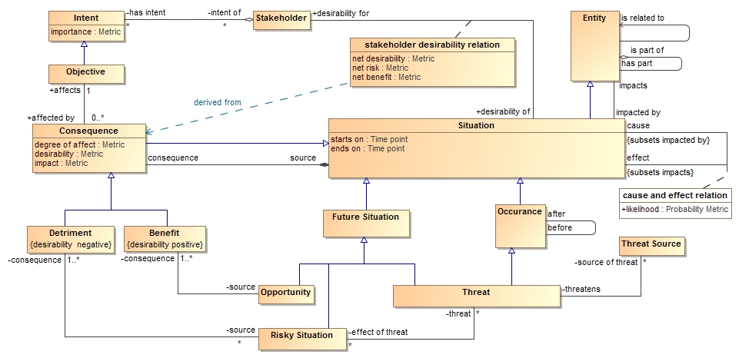
Understanding the UML diagrams & Tables
--todo--
More specific concepts positioned on the bottom

Slide 18
UML Concepts we use
Classes {Entities}
Data types and primitive types {Values}
Associations, associations ends {Relation types}
Properties for values {Simple property relations}
Property defaults {Refinement: An expression evaluated if no values set in context}
Association classes (However, all associations and properties are considered “first class” and can have contextual and time properties)
Subsets and redefines of association ends {Properties of relations}
Cardinalities {Constraint}
Packages & Package URI {Lexical and logical context}
Realization {Representation realizes concept}
Structured Classifier {Patterns and rules}

Slide 19
Profile extension concepts
Classifying packages
Conceptual Model, Physical Model, Mapping
Classification / classifies
Role & Phase
Kinds of types
Entity, Quantity Kind, Unit
Relations
Intersection and Union classes
Equivalent with, disjoint with, is in context of, Restriction
Represents
Rule {Mapping}

Slide 20
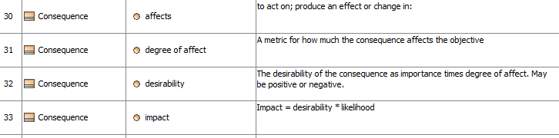
Representing the data and schema
Options
UML Diagrams
Tables
Schema

Slide 21
Modeling Convention – General Relations
In the conceptual model
In a representation (E.G. STIX)
It is typical in a data model and some ontologies to have many specializations for the same relation concept, but different “end types”.
In the conceptual model we have the general concept “related <entity>”.
“represents” semantics say that a general relation is only mapped to a more specific representation if the ends of that relation representation also represent the correct end types.
So, one general type covers many more specific relations and properties.
RelatedCampaign <Campaign>
RelatedIndicators <Indicator>
RelatedTTP <TTP>
The pattern is: Related<type> <type>
Etc…
All the above Represent “related <entity>”

Slide 22
Threat/Risk Conceptual Model
Examples of specific risk/threat concepts – intended to show how the conceptual model is being produced

Slide 23
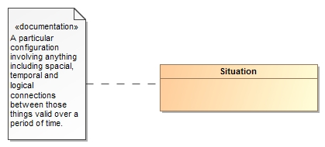
Threats and Risks of What?
A threat or risk is with respect to some undesirable situation
What is a situation?
We define a situation as a configuration of things…
People places, things, events, occurrences and the connections between them.
Some situations are consequences of others
Situations provide a link between different kinds and phases of threats & risks

Slide 24
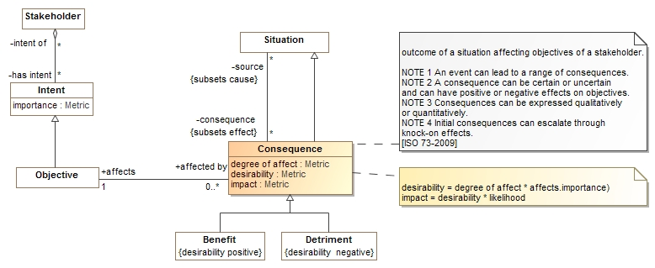
Consequences
Situations may have consequences (an effect of the situation)
Consequence can be positive or negative: benefits or detriments, respectively
Consequences affect the objectives of stakeholders
This leads to the desirability of the consequence (positive or negative)
Desirability * likelihood provide the impact (→risk metric for detriments)

Slide 25
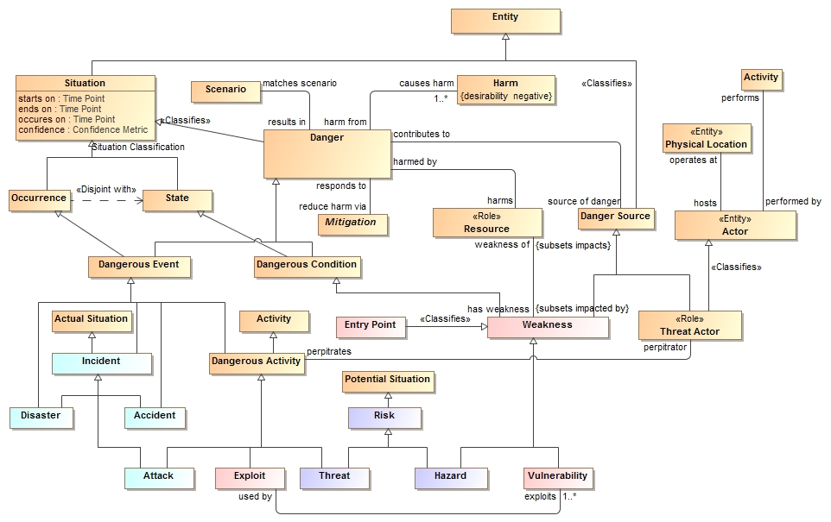
“Danger” as the threat/risk common abstraction (Firesmith)

Slide 26
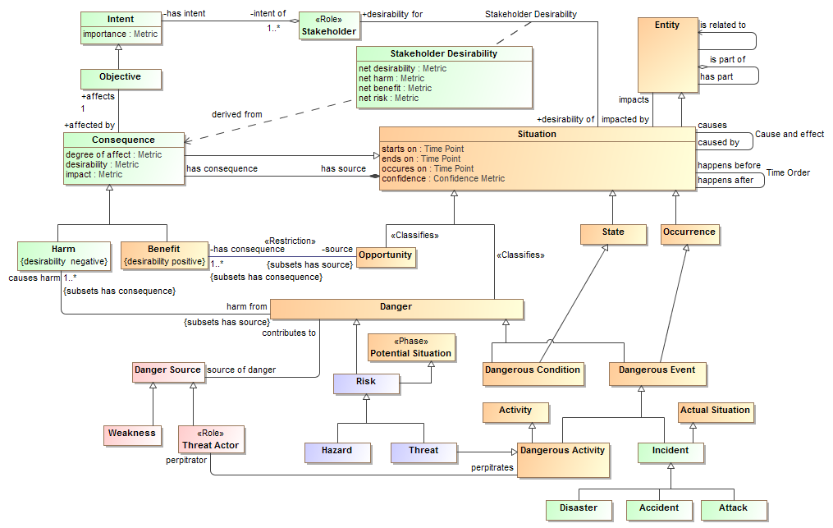
Core Risk/Threat Concepts Overview

Slide 27
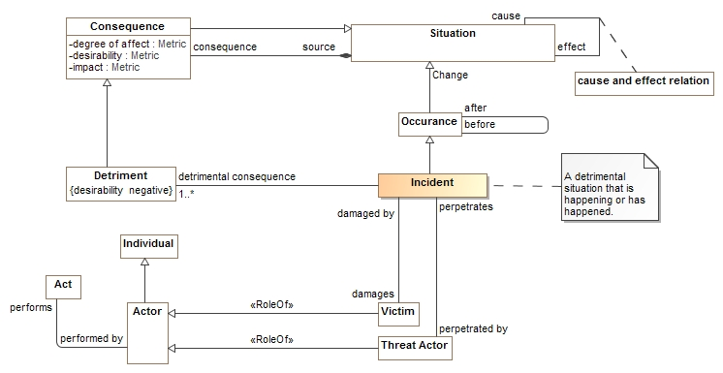
Incidents

Slide 28
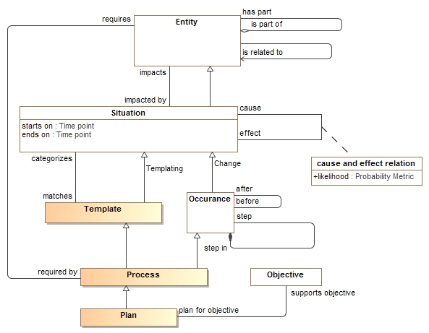
Processes and plans

Slide 29
Abstract types
When we create a new verb concept, we ask “what is the most general possible “ends” of that concept.
If necessary we add abstract super types, there tend to be just a few of these.
So we end up with a hierarchy of very general concepts.

Slide 30
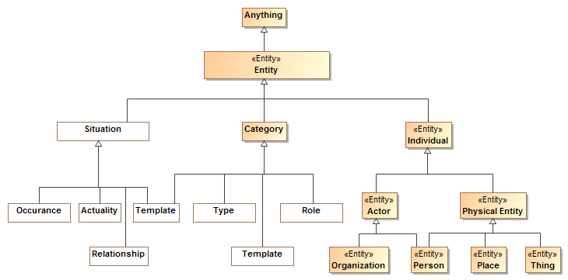
Kinds of entities

Slide 31
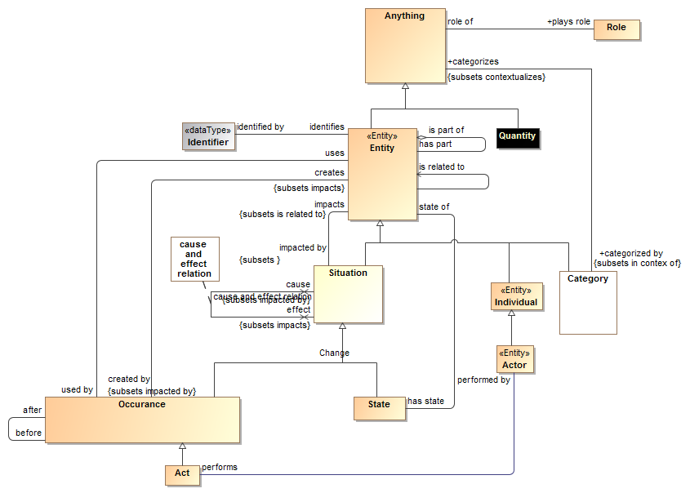
Example abstract concepts (types and relations)

Slide 32
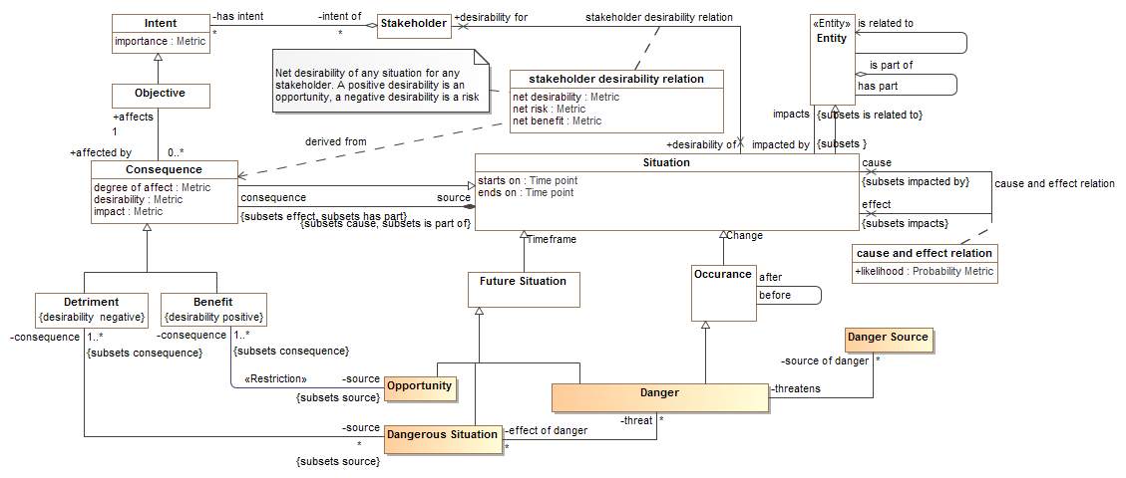
Abstract concepts are then supertypes of Risk/Threat specific concepts
General Framework
Threat specific

Slide 33
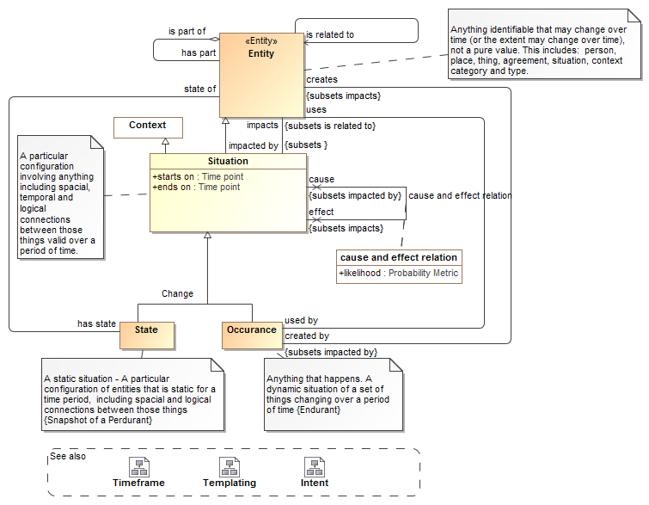
Each concept has a definition and focus diagram
These are also important upper concepts to understand

Slide 34
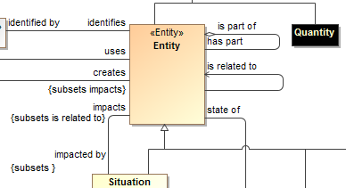
Hierarchy of verb and property concepts
Like types, verbs and relation roles can also form a hierarch and specialize each other
This is defined with UML “subsets” and Redefines”
Subsets defines a refinement of another end, but still allows the original definition
Redefines does not allow the original definition in the new context
This is like “subproperty” in OWL and RDF

Slide 35
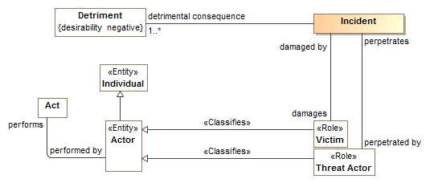
Roles
Roles define what something is for or how it behaves in a certain context, not “what it is”.
A role <<Classifies>> what it can be a role of.
An entity can play any umber of roles and these roles may change over time.
Roles can be contextual

Slide 36
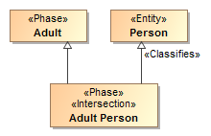
Phases
Phases (or states) are classifications of objects over their lifetime.
Examples: Child, Teenager, Adult or Invoiced, Late, Paid

Slide 37

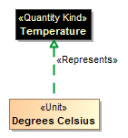

Quantity Kinds
For numeric properties, we want to know what it means (e.g. Temperature), not the kind of number (Real).
<<Quantity Kind>> is an aspect common to mutually comparable quantities represented by one or more units.
A unit represents a quantity kind, there are multiple units representing temperature.
A physical representation would then represent the unit as some kind of number in a specified unit.

Slide 38
Mapping Semantics
High-level mapping as “represents” relations at the type level
Detail mappings as template patterns using UML
Mappings are bi-directional
Mapping patterns are still be proven in prototype

Slide 39
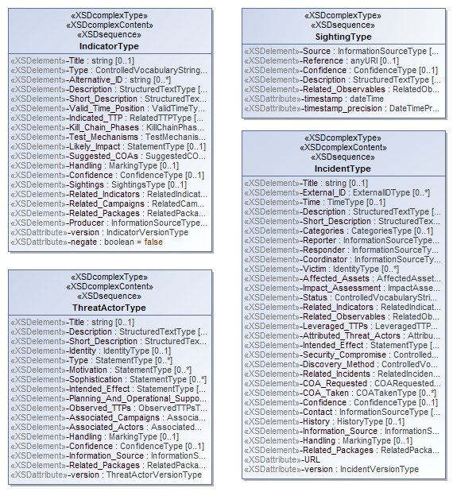
Representing the STIX physical model
<xs:complexContent>
<xs:extension base="stixCommon:IndicatorBaseType">
<xs:sequence>
<xs:element name="Title" type="xs:string" minOccurs="0">
<xs:annotation>
<xs:documentation>The Title field provides a simple title for this Indicator.</xs:documentation>
</xs:annotation>
</xs:element>
<xs:element name="Type" type="stixCommon:ControlledVocabularyStringType" minOccurs="0" maxOccurs="unbounded">
<xs:annotation>
<xs:documentation>Specifies the type or types for this Indicator.</xs:documentation>
<xs:documentation>This field is implemented through the xsi:type controlled vocabulary extension mechanism. The default vocabulary type is IndicatorTypeVocabularyType in the http://stix.mitre.org/default_vocabularies-1 namespace. This type is defined in the stix_default_vocabularies.xsd file or at the URL http://stix.mitre.org/XMLSchema/default_vocabularies/1.1.1/stix_default_vocabularies.xsd.</xs:documentation>
<xs:documentation>Users may also define their own vocabulary using the type extension mechanism, specify a vocabulary name and reference using the attributes, or simply use this as a string field.</xs:documentation>
</xs:annotation>
</xs:element>
<xs:element name="Alternative_ID" type="xs:string" minOccurs="0" maxOccurs="unbounded">
<xs:annotation>
<xs:documentation>Specifies an alternative identifier (or alias) for the cyber threat Indicator.</
XML Schema is reverse engineered into UML

Slide 40
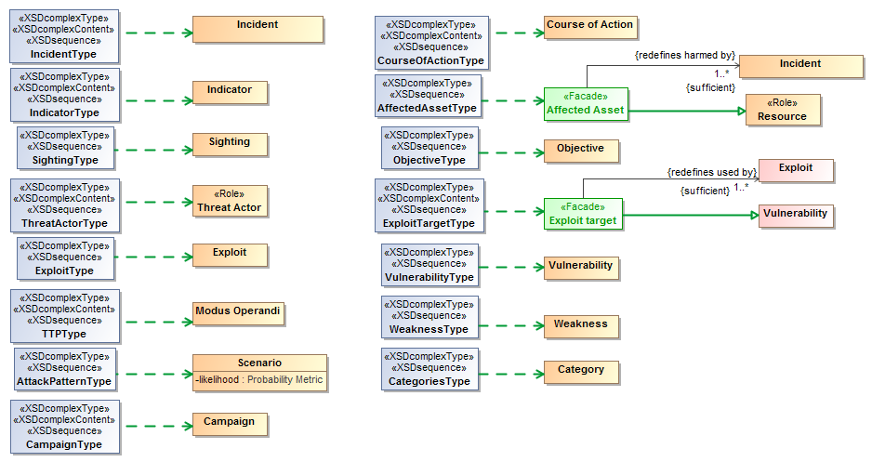
XML Representation represents concept
We start with the high-level classes

Slide 41
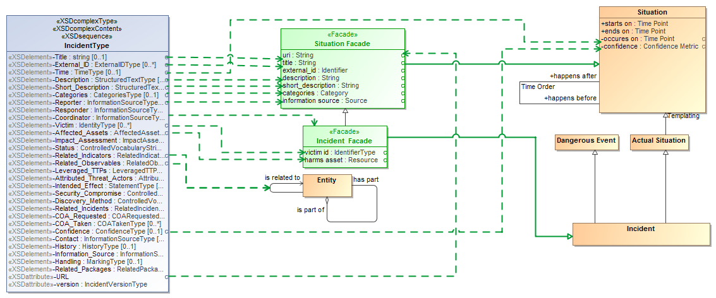
“Facades” provide mapped views of the conceptual model

Slide 42
Physical/logical elements represent concepts (may be in facades)

Slide 43
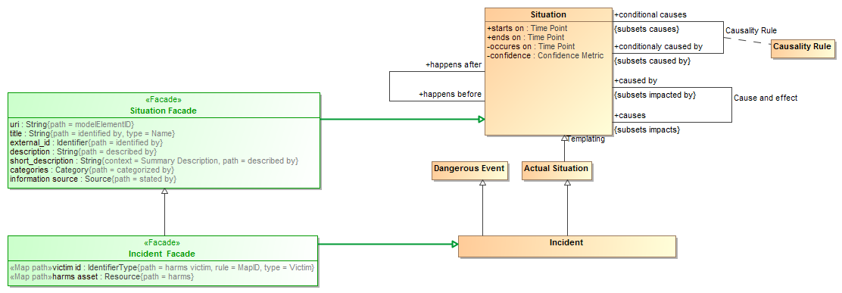
Facades utilize representations and property paths

Slide 44
Facades utilize representations and property paths

Slide 45
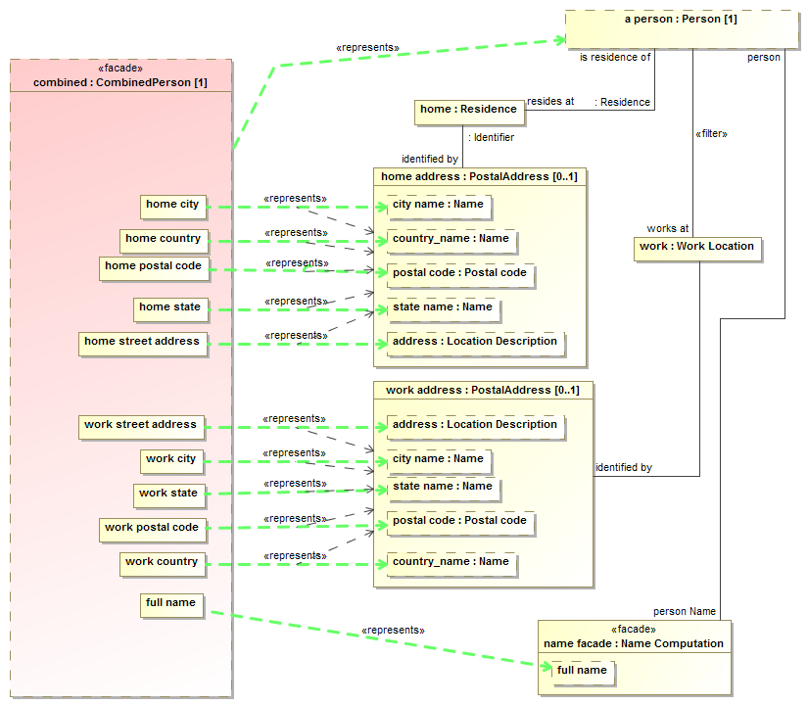
Mapping patterns for complex relations

Slide 46
Example STIX source data
<stix:Incident id="example:incident-fd56fb34-af59-47b3-95cf-7baaaa53fe93" timestamp="2014-08-28T16:42:52.859547+00:00" xsi:type='incident:IncidentType' version="1.1.1">
<incident:Title>Breach of Canary Corp</incident:Title>
<incident:Time>
<incident:Incident_Discovery precision="second">2013-01-13T00:00:00</incident:Incident_Discovery>
</incident:Time>
<incident:Description>Intrusion into enterprise network</incident:Description>
<incident:Reporter>
<stixCommon:Description>The person who reported it</stixCommon:Description>
<stixCommon:Identity id="example:Identity-5db269cf-e603-4df9-ae8c-51ff295abfaa">
<stixCommon:Name>Sample Investigations, LLC</stixCommon:Name>
</stixCommon:Identity>
<stixCommon:Time>
<cyboxCommon:Produced_Time>2014-03-11T00:00:00</cyboxCommon:Produced_Time>
</stixCommon:Time>
</incident:Reporter>
<incident:Victim id="example:Identity-c85082f3-bc04-43c8-a000-e0c1d0f2c045">
<stixCommon:Name>Canary Corp</stixCommon:Name>
</incident:Victim>
<incident:Impact_Assessment>
<incident:Effects>
<incident:Effect xsi:type="stixVocabs:IncidentEffectVocab-1.0">Financial Loss</incident:Effect>
</incident:Effects>
</incident:Impact_Assessment>
<incident:Confidence timestamp="2014-08-28T16:42:52.859570+00:00">
<stixCommon:Value xsi:type="stixVocabs:HighMediumLowVocab-1.0">High</stixCommon:Value>
</incident:Confidence>
</stix:Incident>

Slide 47
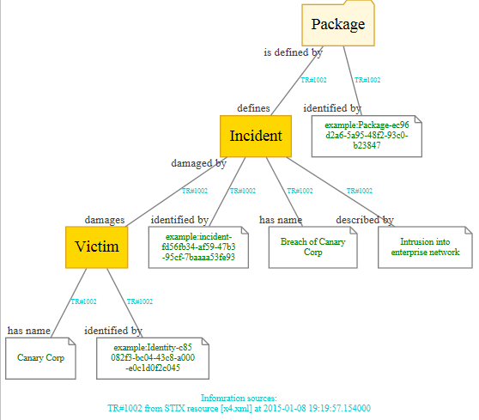
Example of mapped data graph
Provenance

Slide 48
Prototyping
Prototype is intended to validate models and mappings, it is not efficient or production code (yet). It is implemented in Python and all data is in-memory

Slide 49
Prototype Design
Magicdraw
Currently just does STIX
Conceptual
Model
STIX
XML
SIMF-Python Interpret / Export
Python Mapping Code
Files From Model
Rules
Output
Dictionary Spreadsheet
(Concept Labels)
SIMF/ Python Objects
Map rules
SIMF-XML
Objects
Object
Graph
Map log
(Data seen and mapped or not)
Extend
Rules

Slide 50
Example Dictionary
Dictionary
Example
From Model
Entity kinds/Physical Entity | A thing that has mass and takes up space including people, places and things.
UML2 Metamodel/Generalization
Intent/has intent
Context/Type
RiskThreat/has sighting
Possession/possesses
RiskThreat/damages

Slide 51
Map log example
What was mapped to what
MAP:/stix/core/stix_package/STIXPackage.indicators---MAPPED TO---><Indicator "opensource:indicator-45c112fa-805f-4cc0-b17b-2d98b519ca60" as "defines">
NO VALUE FOR RULE:/stix/core/stix_package/STIXPackage.incidents
NO VALUE FOR RULE:/stix/core/stix_package/STIXPackage.ttps
MAP:/stix/base/Entity.id_---MAPPED TO---><"edge:Package-3ffdccc7-bd56-4491-88d1-be3d966e42f8" as "identified by">
NO VALUE FOR RULE:/stix/base/Entity.idref
NO VALUE FOR RULE:/stix/base/Entity.title
NO VALUE FOR RULE:/stix/base/Entity.description.value
------UNMAPPED properties and get methods-------
IN:/stix/core/stix_package/STIXPackage.version = 1.1.1
IN:/stix/core/stix_package/STIXPackage.related_packages = None
IN:/stix/core/stix_package/STIXPackage.timestamp = 2014-11-23 00:12:45.650946+00:00
IN:/stix/core/stix_package/STIXPackage.campaigns = []
Input data to consider

Slide 52
Example rules*
Represents("/stix/ttp/TTP", "Behavior/Modus Operandi")
Represents("/stix/ttp/TTP.behavior", "Core Concepts/step")
Represents("/stix/ttp/behavior/Behavior", "Process/Plan")
Represents("/stix/ttp/behavior/Behavior.malware", "Process/requires")
Represents("/cybox/common/datetimewithprecision/DateTimeWithPrecision",
"Quantities and units/Time point")
Represents("/cybox/common/datetimewithprecision/DateTimeWithPrecision.value", "Quantity/value")
#Entity properties used for all subtypes
RepresentsID("/stix/base/Entity.id_", "Core Concepts/identified by")
RepresentsID("/stix/base/Entity.idref", "Core Concepts/identified by")
Represents("/stix/base/Entity.title", "Information/has name")
Represents("/stix/base/Entity.description.value", "Information/described by")
From schema and map log
From conceptual dictionary
* Currently in text format

Slide 53
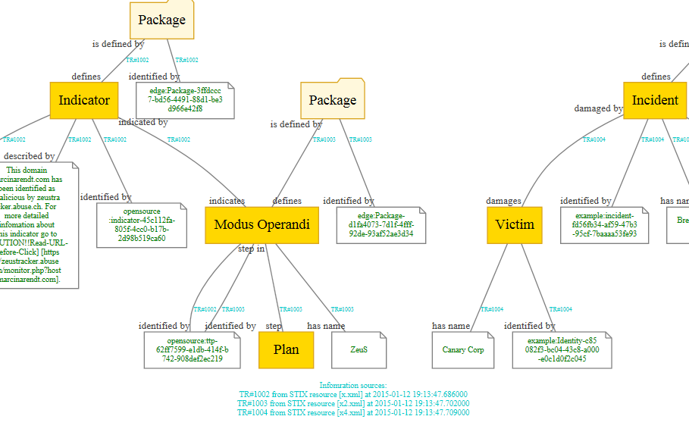
Resulting data graph

Slide 54
Threat/Risk RFP Requirements

Slide 55
Conceptual Models
Submissions shall define modular UML conceptual models to specify the concepts required to represent information about operational threats and risks.
The conceptual model shall capture the intended meaning of operational threat and risk related concepts such that it may be used as a reference for the use of those concepts in specific exchanges and data stores.
The conceptual model shall not assume any particular technology, domain, representation, structure of information or schema. It shall be a model of the concepts representing real-world entities, not of a specific data representation.
Covered

Slide 56
Threat/Risk Concepts To Define
Operational Threat
Operational Risk
Asset
Campaign
Cause
Effect
Exploit target
Goal
Hazard
Impact
Incident
Indicator
Likelihood
Mitigation
Observable
Observation
Observation Metadata
Procedures
Risk
Safeguard
Severity
Strategy
Tactics
Techniques
Threat
Threat actor
Threat source
Undesired event
Covered

Slide 57
Classes of Threat/Risks in scope
Cyber/information and communication systems and assets
Physical systems and assets, including embedded and manufacturing
Electromagnetic spectrum assets (E.g. interference with wireless systems or radio)
Industrial control systems
Covered

Slide 58
Constraints
Defensive, offensive, or other actors may or may not have insight into the plans or strategies of the respective other actors. As such, model implementations will in those cases be incomplete and rely on estimates and assumed parameters.
Models must be able to support non-actor threats (such as natural disasters ) that will not be associated with any coherent intentions or plans.
Bystanders and inadvertent actors may perform actions that result in behavior that provides benefits to any other actor (offensive or defensive). Such actions are understood to be non-intentional.
The focus of risks will be those that go beyond the normal course of business and expose the enterprise to increased risk due to threats & vulnerabilities.
Unclear what level of behavioural modeling you have in mind, but in general it could be expected that an offensive actor would have an understanding of the plans of defensive actors [Done-CBC (Also MH)]
6.5.2.5 Models for operational threats and risks shall include concepts for expressing probability and/or confidence levels (e.g. for likelihood of occurrence and impact)
The conceptual model shall include concepts for understanding, planning for and treating operational risks, threats and their contingencies at the governmental and enterprise level.
Covered

Slide 59
NIEM Representation & Mapping
Submissions shall define a normative NIEM-UML PIM representation sufficient to capture the concepts as defined in the conceptual models as defined above.
This NIEM-UML representation shall be mapped to the conceptual models such that the meaning of each threat/risk relevant NIEM element is described in the conceptual model.
The mapping shall be sufficiently expressive such that any set of instances represented in or logically mapped to the conceptual model shall be able to be represented in NIEM (understanding that choices and rules will have to be made).
Any instance of the NIEM specification shall be able to be logically mapped to the conceptual model.
Started

Slide 60
STIX Mapping
Submissions shall define a mapping to the subset of STIX that corresponds with the conceptual model. This mapping shall demonstrate that the conceptual model is sufficient to represent high-level STIX concepts.
Started

Slide 61
Common Requirements
All models shall utilize UML and UML profiles as a foundation.
Concepts that are required for understanding threats or risks should, as much as possible, be defined in a modular fashion such that these concepts may be reused for related threat/risk concepts NIEM and other reference models shall be used as a reference for such cross-domain concepts.
Covered

Slide 62
Optional Mappings
Submissions may provide normative or non-normative mappings to support the following Platform Specific Models, or logical models for the following protocols or communities:
OASIS Common Alerting Program & EDXL
Others as deemed important by submitters
EDXL and others as input
Mappings anticipated

Slide 63
Optional support for conceptual modeling and mapping
Submissions may reference and/or define non-normative UML profiles and associated QVT (or other ways to express mapping logic) for conceptual modeling and the mapping.
Submitters are encouraged to follow the progress of and use as appropriate SIMF, ODM, MDMI, semantic web and other efforts to help define conceptual models and mappings.
Covered - SIMF

Slide 64
MOF Representation
Submissions may define A MOF metamodel that utilizes the conceptual model and provides an XMI representation of Operational Threats and Risks.
Covered
Using UML

